Slide 1


[ACL22] Continual Few-shot Relation Learning via Embedding Space Regularization and Data Augmentation
${Chengwei Qin}^{1}$, ${and Shafiq Joty}^{1,2}$
$$Nanyang Technological University^{1},$$
$${Salesforce Research}^{2}$$
{chengwei003@e.ntu, srjoty@ntu}@.edu.sg
Xuanwen Ding

Slide 2
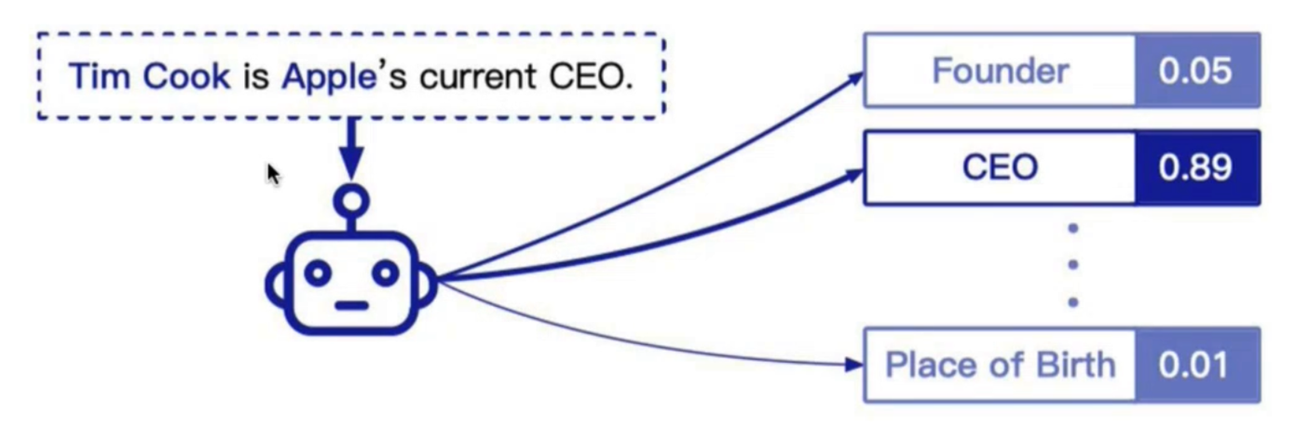
Motivation
Relation extraction aims to detect the relationship between two entities in a sentence
Open-vocabulary problem
Relation set keeps growing as new data emerges.

Slide 3
Motivation
Problem of CRL: Catastrophic Forgetting
Existing methods to alleviate forgetting:
Regularization-based methods
Architecture-based methods
Memory-based methods: most effective in NLP (so far)

Slide 4
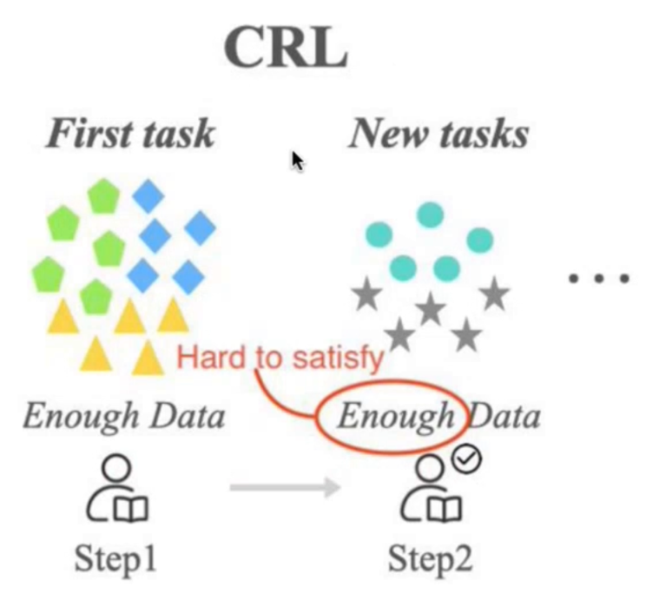
Motivation
Limitation: CRL assumes plenty of training data for learning every new task.
Few-shot: over-fitting

Slide 5
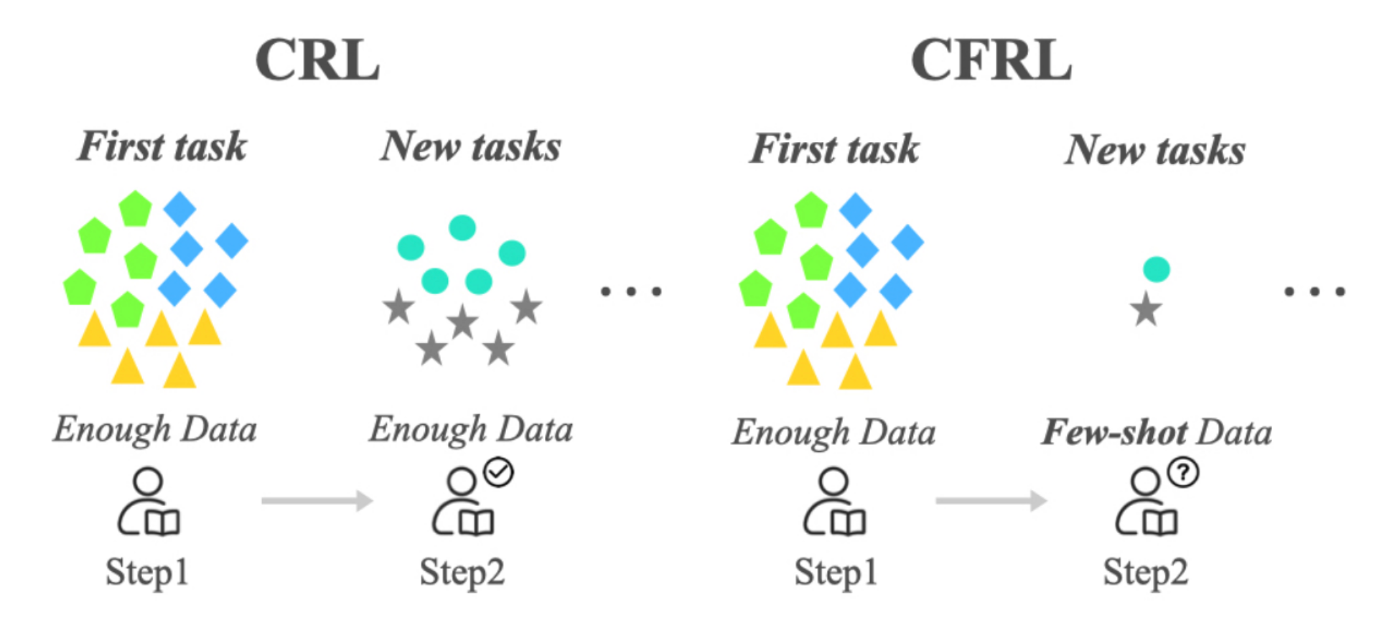
CRL VS CFRL

Slide 6
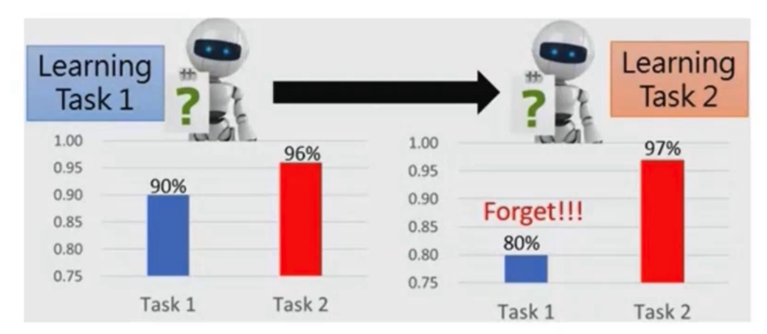
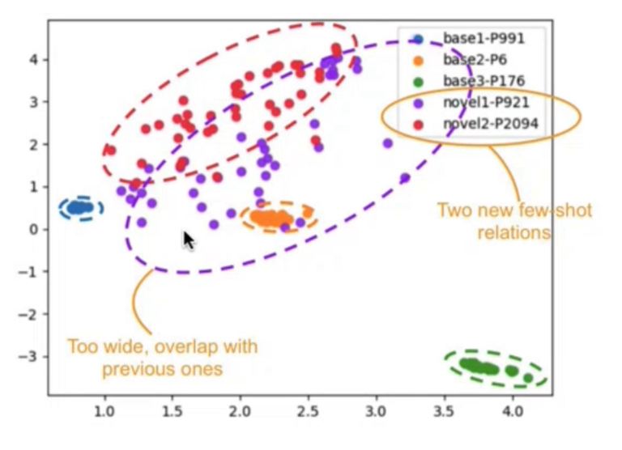
Challenge
Continual Few-shot Relation Learning
Over-fitting
Feature distributions of new tasks get distorted due to few examples.
Catastrophic Forgetting
New distorted feature distributions are incompatible with previously learned embedding space.
The learning of new data updates model parameters.

Slide 7
Reason
Feature distributions of new tasks are distorted due to few examples. (reason 1）
The learned optimal embedding space of previous tasks is changed due to the update of model parameters. (reason 2）

Slide 8
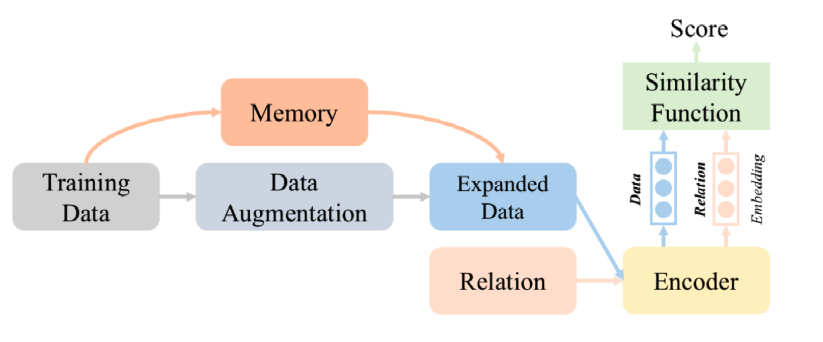
Proposed Method
Proposed ERDA: Embedding Space Regularization and Data Augmentation

Slide 9
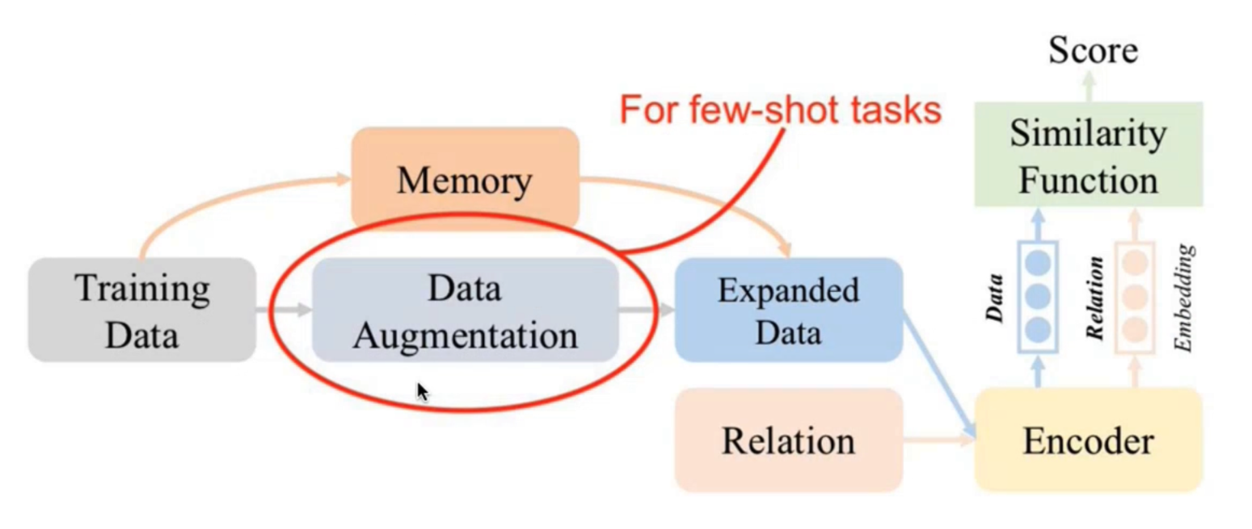
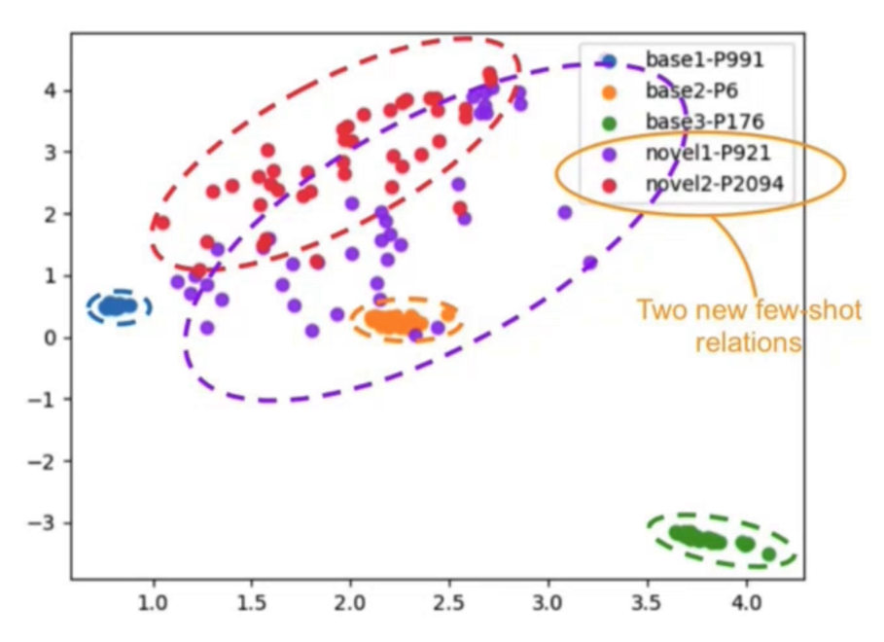
Proposed Method
Embedding Space Regularization
We introduce several margin-based losses to
learn better feature distributions of new few-shot tasks.
better recover from the distorted embedding space of previously learned tasks.
Data Augmentation
We introduce a data augmentation module to learn new few-shot tasks.
reason 1 [1]
reason 2 [2]
reason 1 [1]
[1] Feature distributions of new tasks are distorted due to few examples.
[2] The learned optimal embedding space of previous tasks is changed due to the update of model parameters.

Slide 10
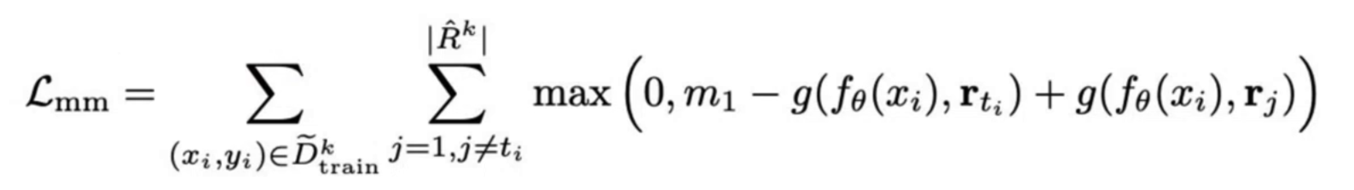
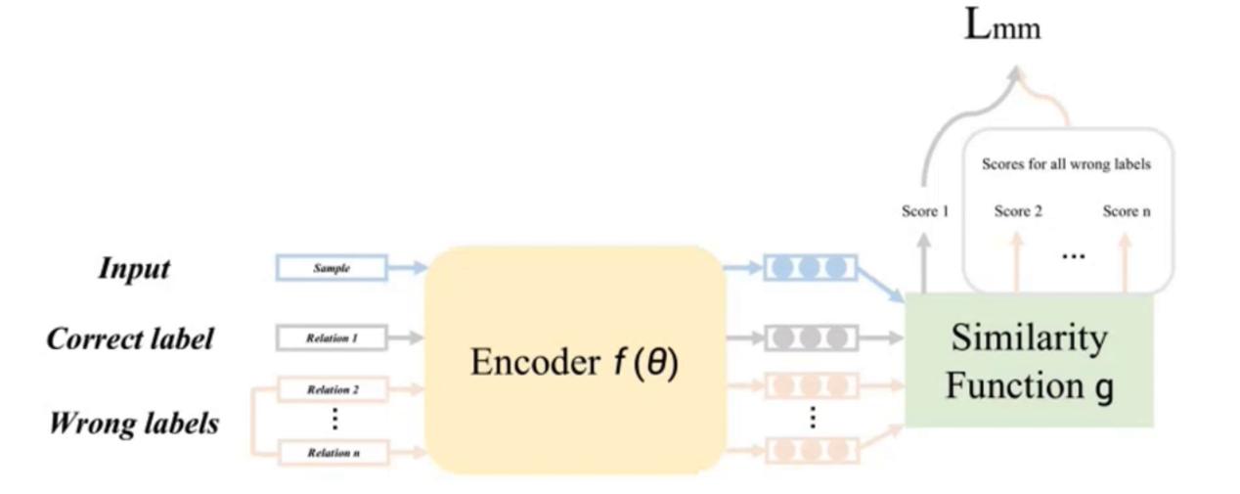
Embedding Space Regularization
We introduce several margin-based losses to
learn better feature distributions of new few-shot tasks.
better recover from the distorted embedding space of previously learned tasks.
reason 1
reason 2
Multi-margin loss $L_{mm}$

Slide 11
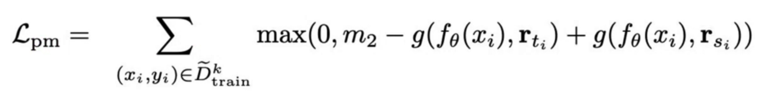
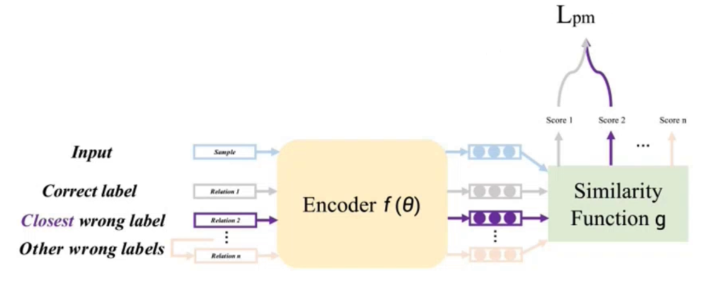
Embedding Space Regularization
We introduce several margin-based losses to
learn better feature distributions of new few-shot tasks.
better recover from the distorted embedding space of previously learned tasks.
reason 1
reason 2
Pairwise margin loss $L_{pm}$

Slide 12
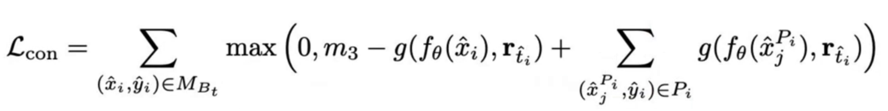
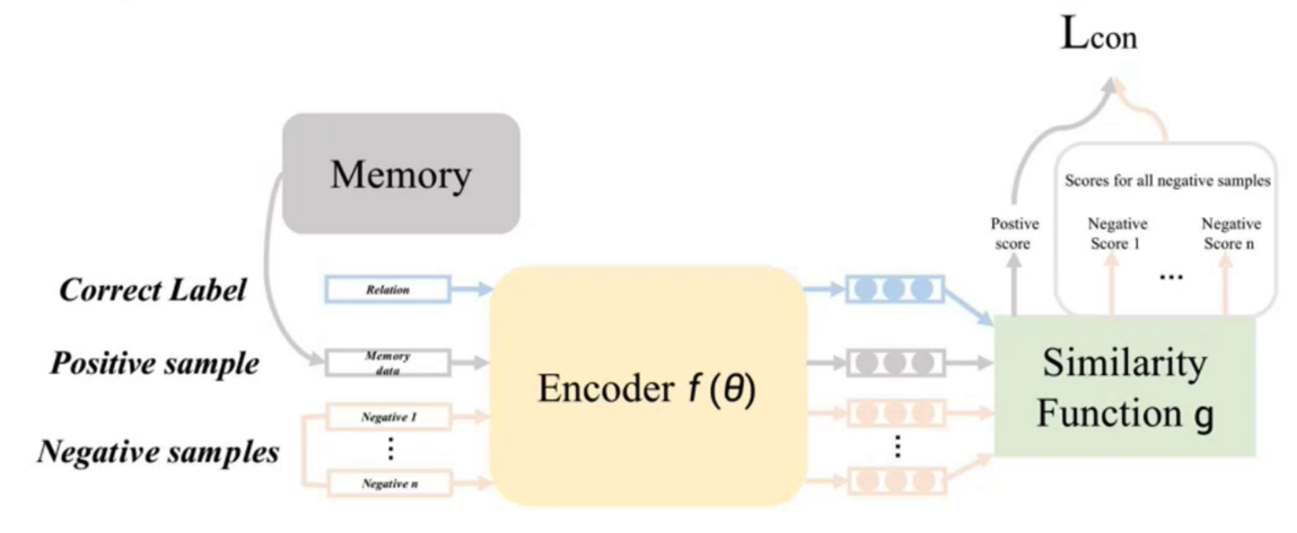
Embedding Space Regularization
We introduce several margin-based losses to
learn better feature distributions of new few-shot tasks.
better recover from the distorted embedding space of previously learned tasks.
reason 1
reason 2
Margin-based contrastive loss $L_{con}$on memory data

Slide 13
Data Augmentation
We introduce a data augmentation module to select informative samples from an unlabeled corpus.
Entity Matching
Select sentences sharing same entity pairs with the input sample.
Use a pre-trained relational similarity model to filter these sentences.
Similarity Search
Use Faiss [1] to select top-K most similar sentences.
Sentence embeddings are provided by the pre-trained relational similarity model.
reason 1
[1] Billion-scale similarity search with gpus. Johnson J et. al. in IEEE Transactions on Big Data, 2019

Slide 14
Benchmark & Metric
FewRel [1] and TACRED [2]
We divide both datasets into 8 tasks (1 full-shot + 7 few-shot) for continual learning.
Evaluation metric: relation classification accuracy on the test sets of all seen tasks.
[1] FewRel: A large-scale supervised few-shot relation classification dataset with state-of-the-art evaluation. Han et. al. In EMNLP 18
[2] Position-aware attention and supervised data improve slot filling. Zhang et. al. In EMNLP 17

Slide 15
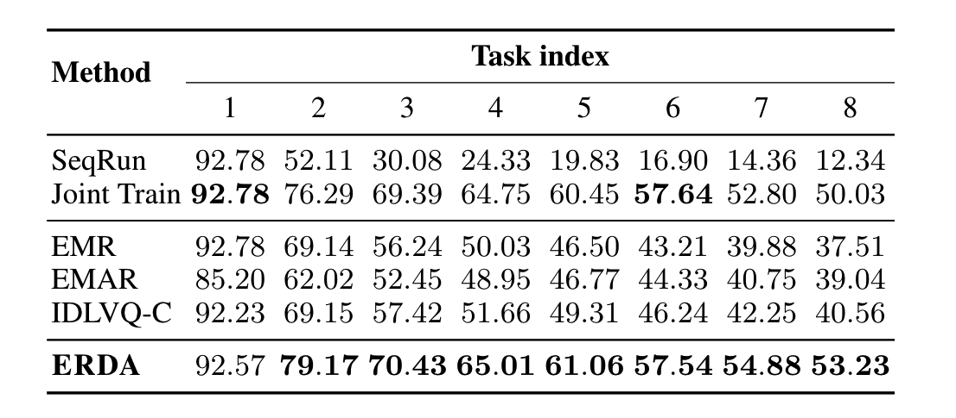
Main Results
FewRel， 10-way 5-shot

Slide 16
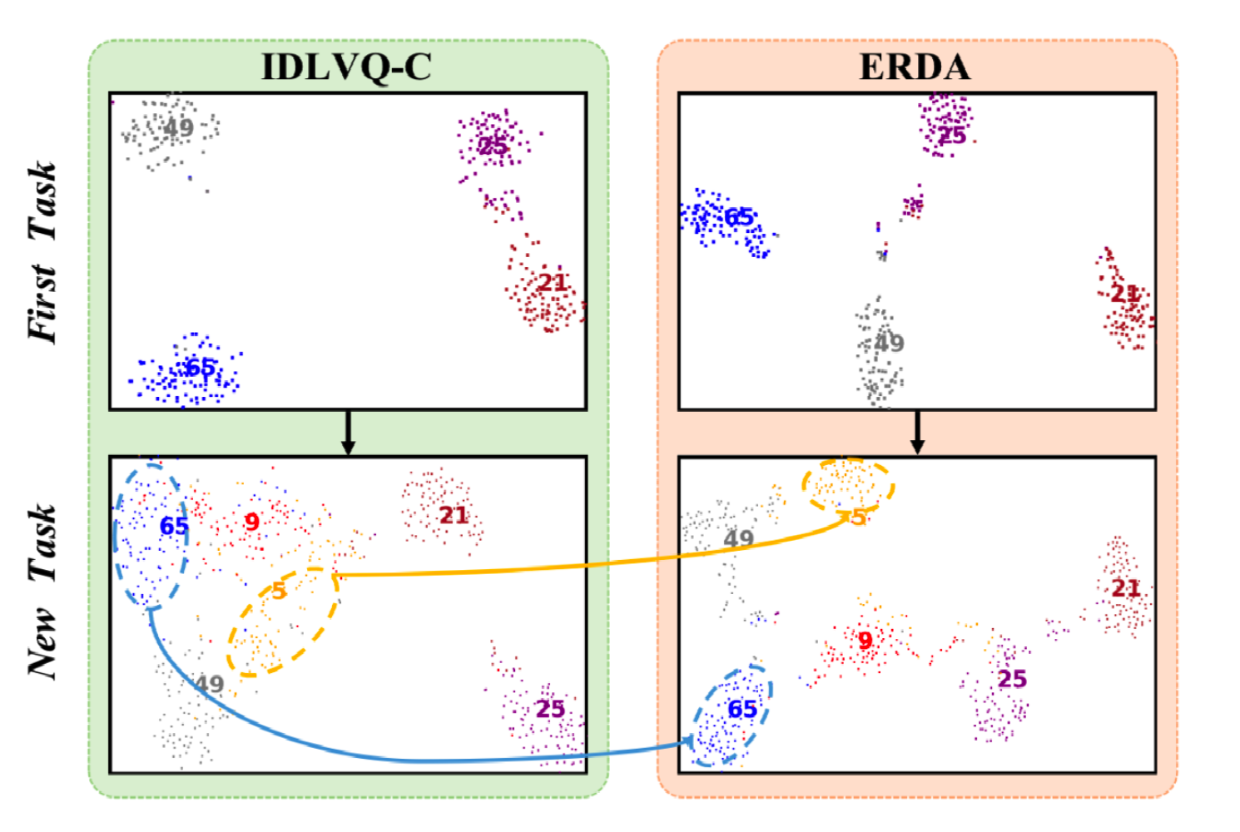
Visualization

Slide 17
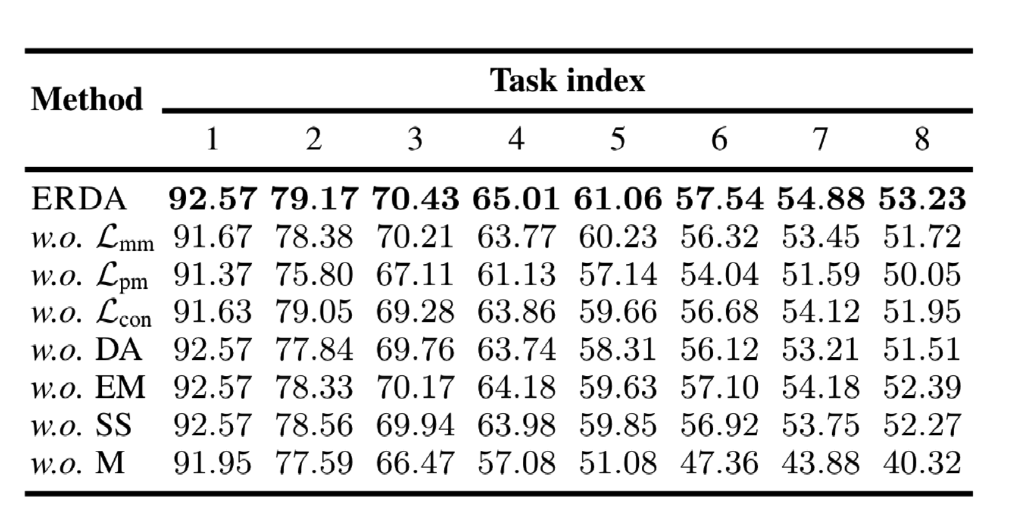
Ablation Study
FewRel， 10-way 5-shot

Slide 18
Conclusion
We introduce the continual few-shot relation learning (CFRL) problem.
We propose embedding space regularization and data augmentation (ERDA) to solve the over-fitting and forgetting problems in CFRL.

